Slide 1
Introduction
Name: Social Media Platform
(Group 21)
Team Members: Bestha Srihari, Devika B, Yelleti Yamini, Nilesha Bajpayee, Subha Raju, Sravan Kumar Kondeti, Monisha D
Application Developed: GitHub (Statistics).
Requirements: Develop a social media dashboard that aggregates data from various platforms, displaying statistics, insights, and facilitating user registration and login.
Learning: Proficiency in Prompt Engineering, React, Katalon, Selenium, Groovy and Kalilinux.
Testing: Manual and Automated Testing, including cybersecurity checks.

Slide 2
Challenges and Learnings
Challenges:
Inconsistent Responses.
Limited Scalability.
Time Constraints.
Due to lack of experience in the technology we used to get some errors that we were not familiar with.
Experience of using ChatGPT:
Quality of the code got enhanced after using ChatGPT.
Adaptation to Technological Trends.
24/7 Availability.
Code Review – ChatGPT helps us to understand the specific error and how to resolve that.

Slide 3
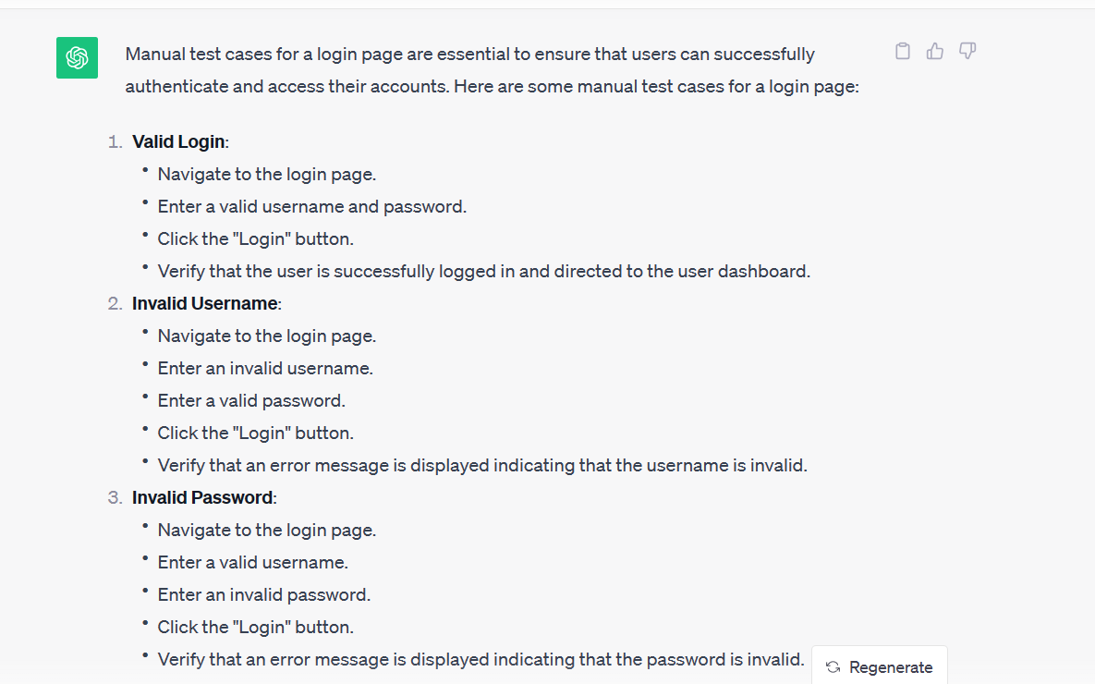
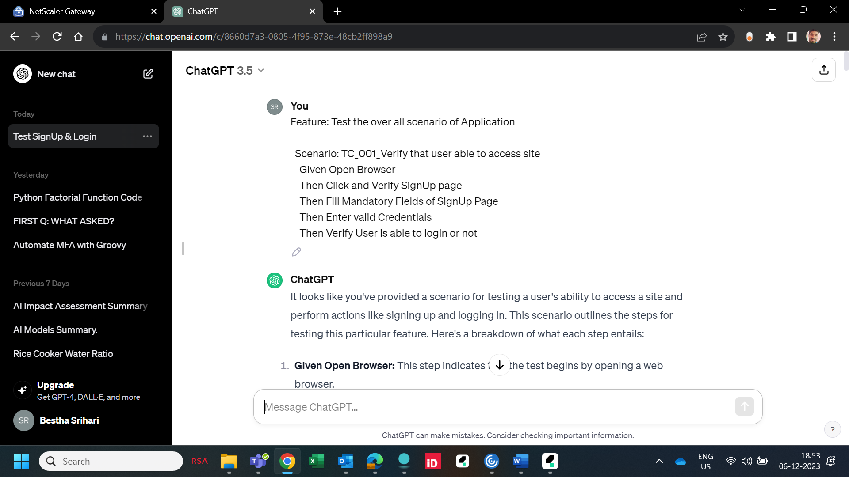
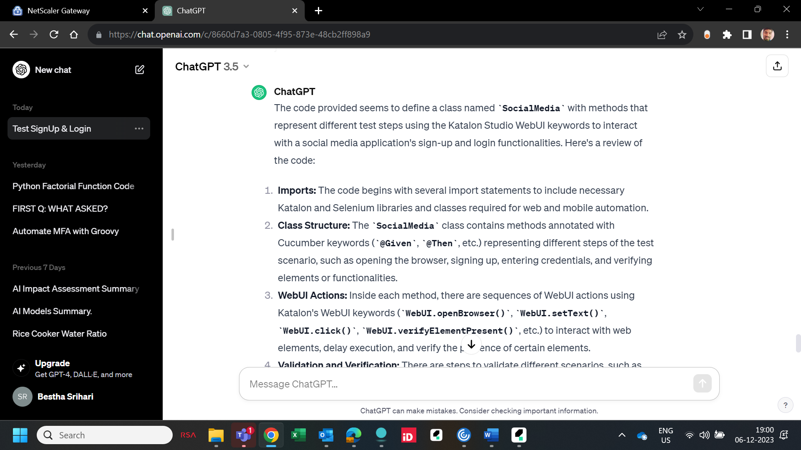
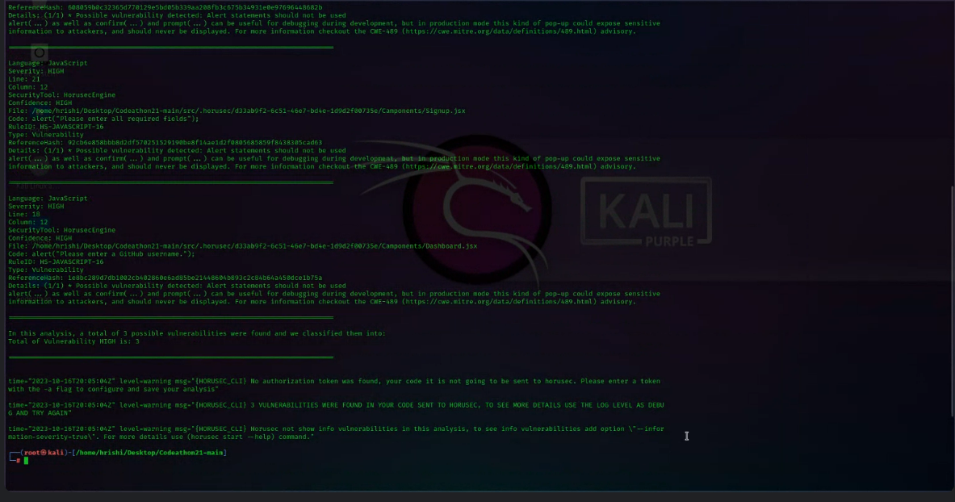

Slide 4
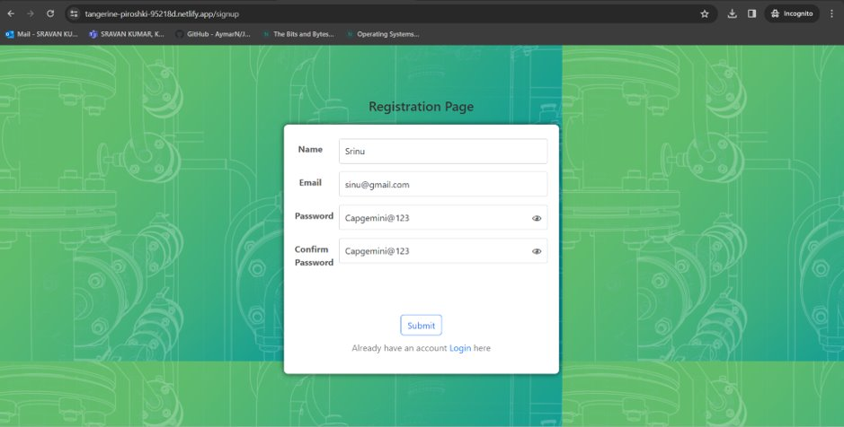
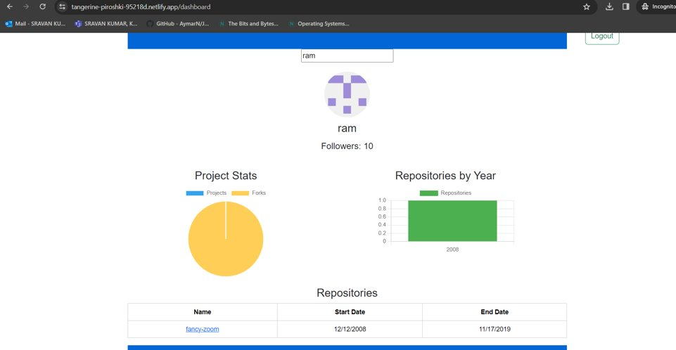
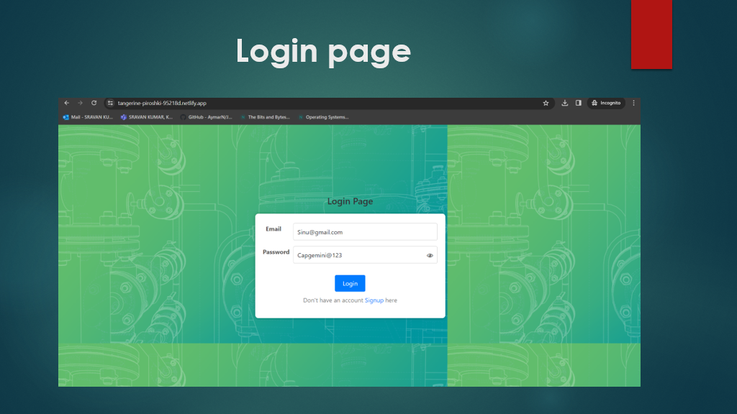
Search box to search the user

Slide 5
Future Benefits
Benefits:
- Comprehensive Understanding of Project Workflow.
- Insight into Development, Cybersecurity, Manual Testing, and Automation Testing methodologies.
- Exposure to Various Technologies.
- Networking Opportunities
Relevance:
The Codeathon experience is particularly relevant in several key areas:
- Effective Time Management.
- Enhanced Team Interaction and Collaboration.
- Meeting Project Deadlines.
- Successful Deployment of Projects.

Slide 6

Thank You! We extend our sincere gratitude to everyone involved in making this project a success: - Our Team Members: Bestha Srihari, Devika B, Yelleti Yamini, Nilesha Bajpayee, Subha Raju, Sravan Kumar Kondeti, Monisha D. - Mentors and Organizers: G Saranya, MG Sowmya, Ankireddypalli, Kishore Kumar Reddy. - All Contributors and Supporters. Your guidance, support, and contributions have been valuable in our journey. Thank you for your trust and encouragement. (Group 21 - Social Media Project)

